Slide 1
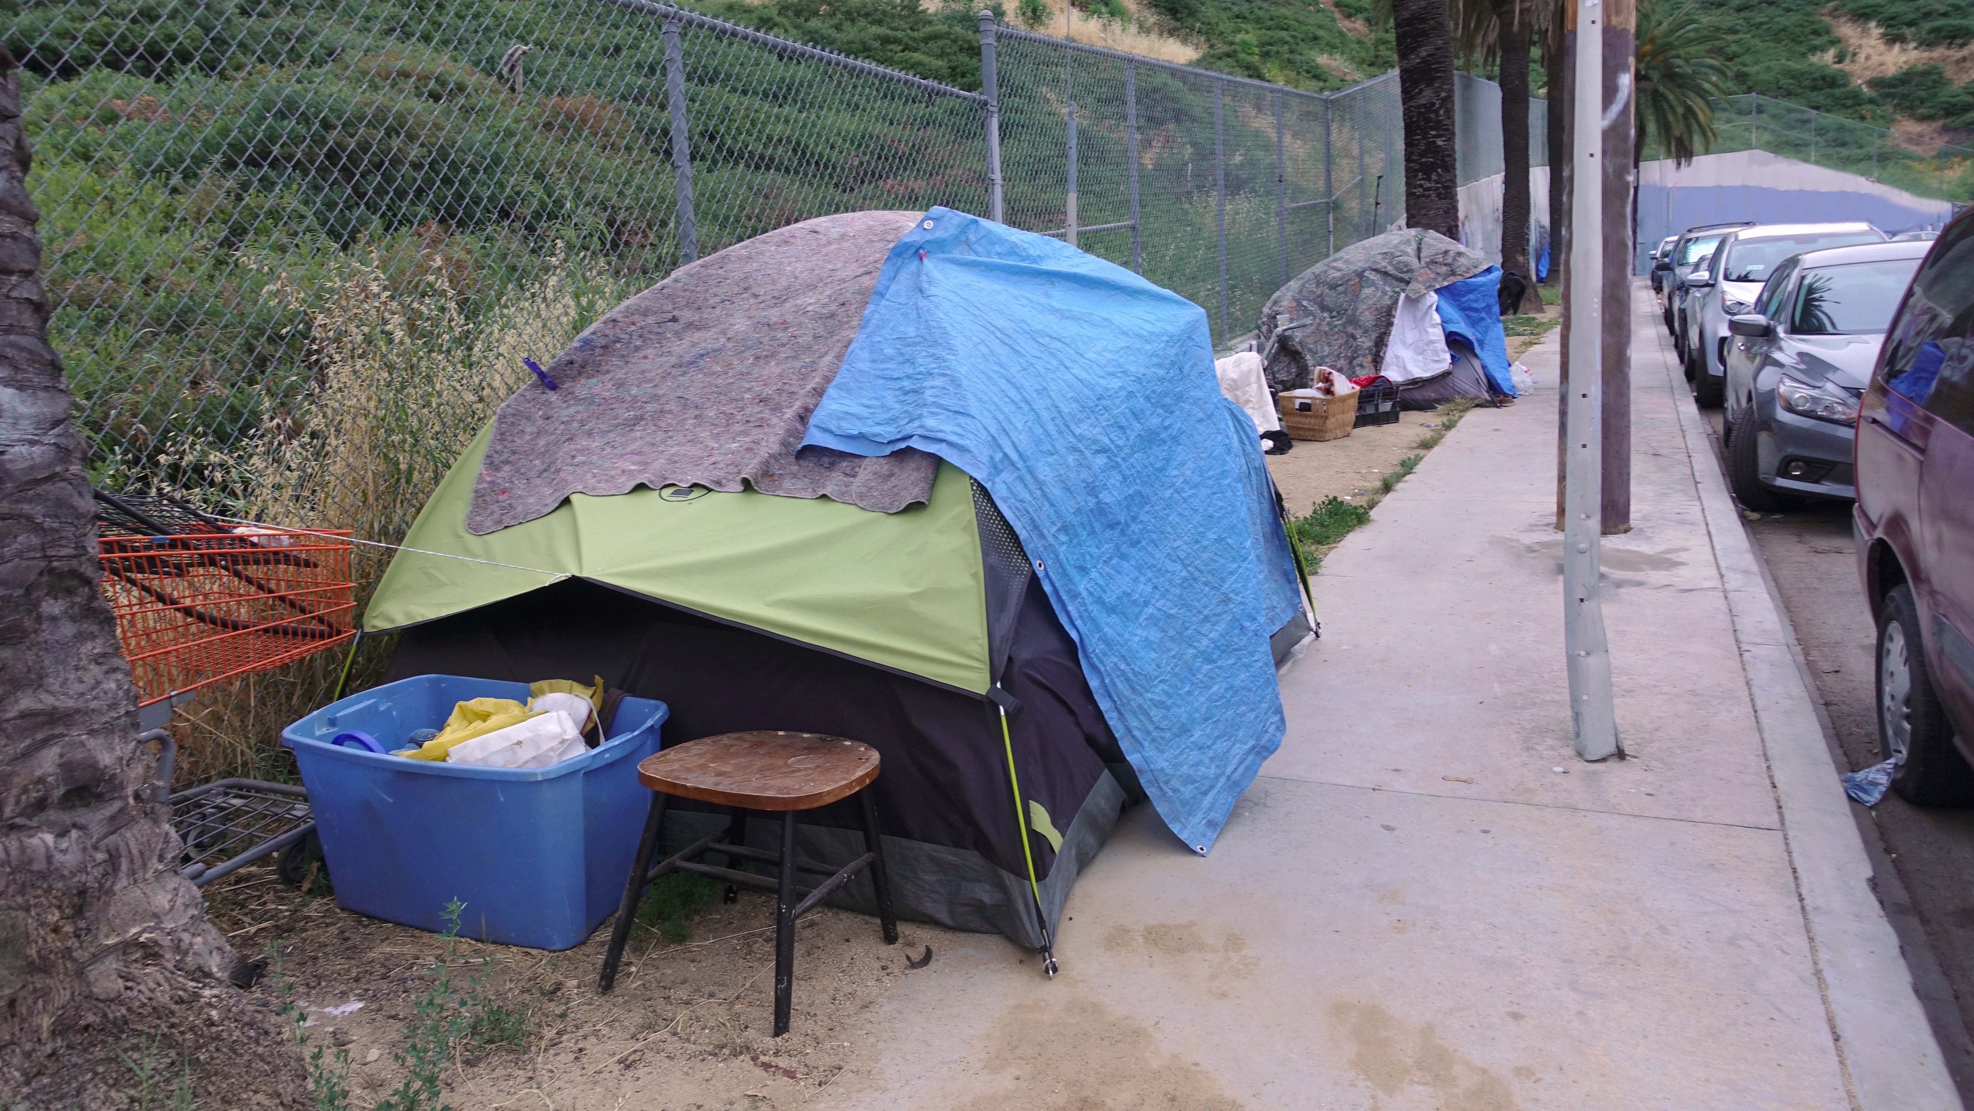


Society of Saint Vincent de Paul
Please donate on
November 17
World Day
of the Poor.
To make a donation,
please contact us:
ssvp.ca/donate
Charity Registration No: 132410671RR0001

Slide 2
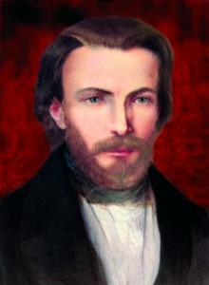
Blessed Frédéric Ozanam
“Charity is the Samaritan who pours oil on the wounds of the traveler who has been attacked.
It is social justice’s role to prevent the attack.”

Slide 3
Society of Saint Vincent de Paul
MISSION
The Society of Saint Vincent de Paul (SSVP) is a lay
Catholic organization whose mission is:
To live the Gospel message by serving Christ in the poor with love, respect, justice and joy.

Slide 4
Society of Saint Vincent de Paul
VALUES
The Mission of the Society of Saint Vincent de Paul implies that as Vincentians, we:
see Christ in anyone who suffers;
come together as a family;
have personal contact with the poor;
help in all possible ways.

Slide 5
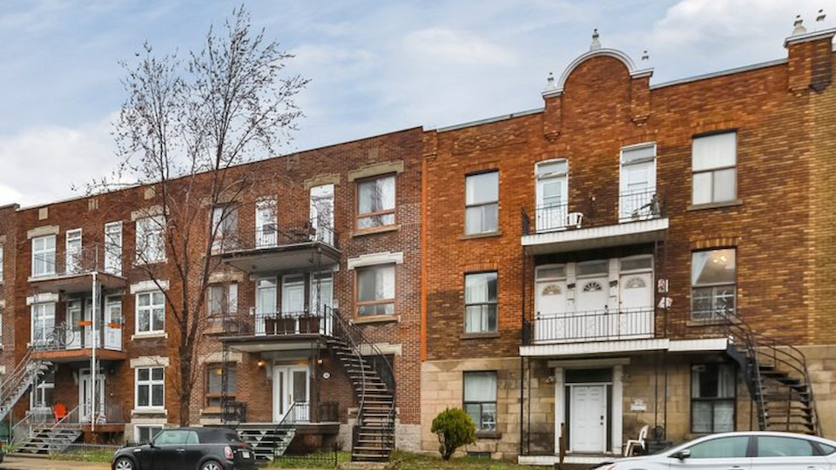
Works of SSVP in Canada
162,300 visits made

Slide 6
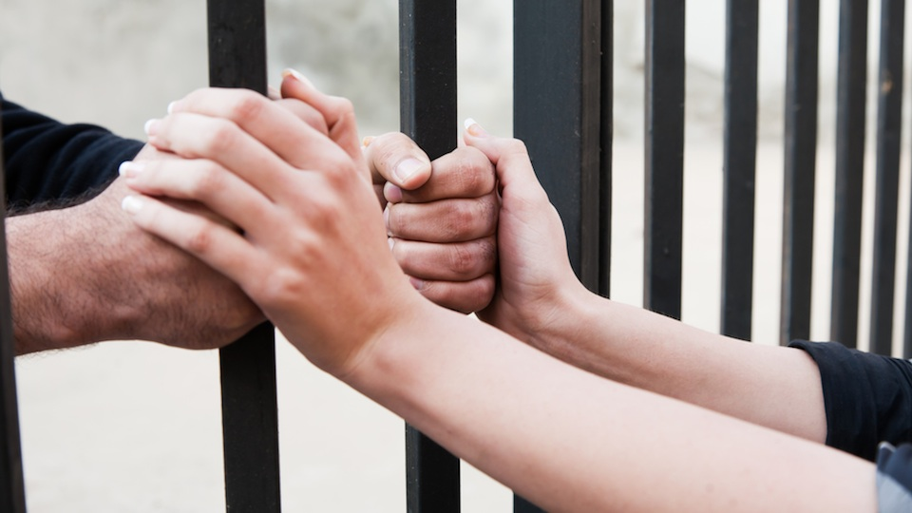
Works of SSVP in Canada
Visits to prisoners

Slide 7
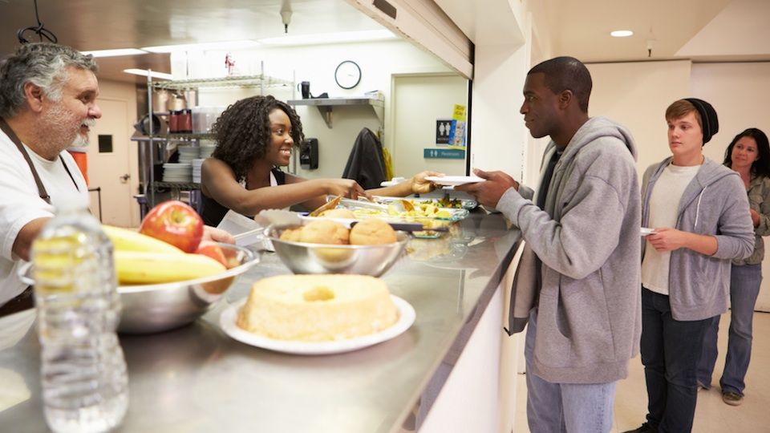
Works of SSVP in Canada
137 food banks & soup kitchens

Slide 8
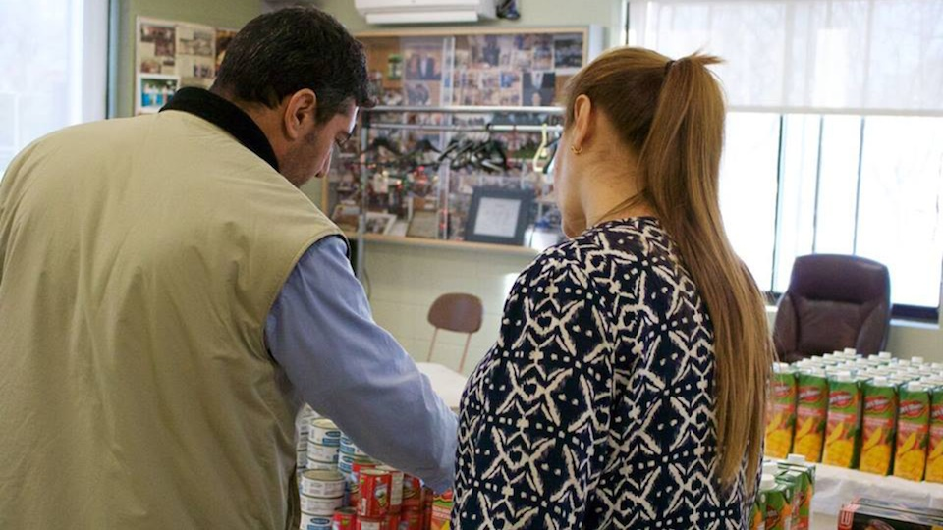
Works of SSVP in Canada
112,300 meals served at soup kitchens
145,000 people served at food banks

Slide 9
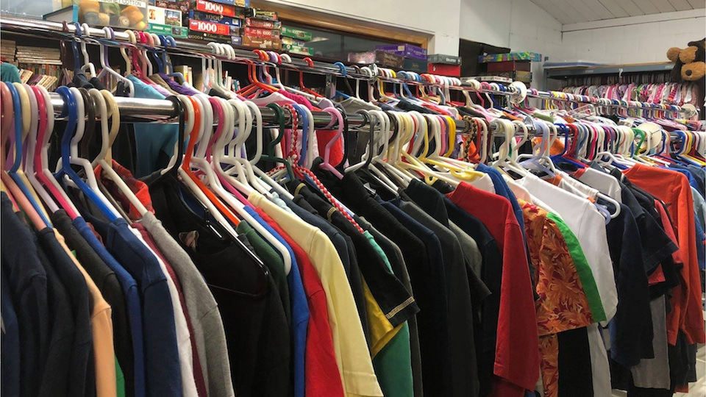
Works of SSVP in Canada
Material help
$6,251,500 worth of clothes & furniture

Slide 10

Works of SSVP in Canada
232,700 people helped at home

Slide 11

Works of SSVP in Canada
11,810 houseless individual and families helped

Slide 12

Works of SSVP in Canada
Educational support
School supplies

Slide 13

Works of SSVP in Canada
Educational support
Scholarships

Slide 14

Works of SSVP in Canada
Help to refugees & immigrants

Slide 15

Works of SSVP in Canada
7,235 people welcomed in shelters

Slide 16
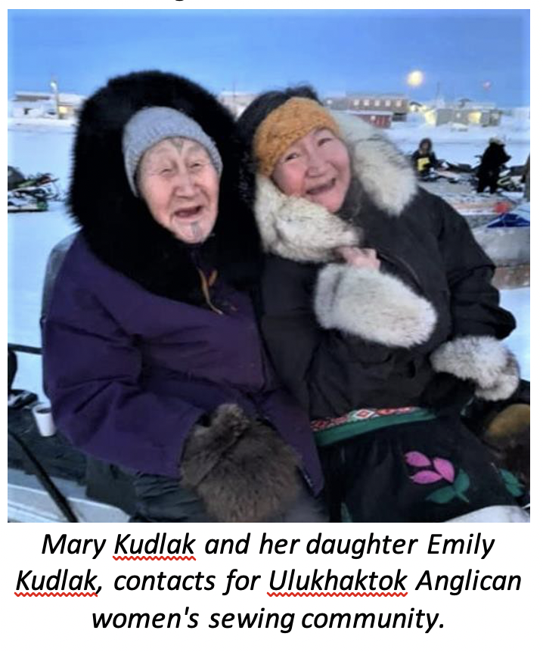
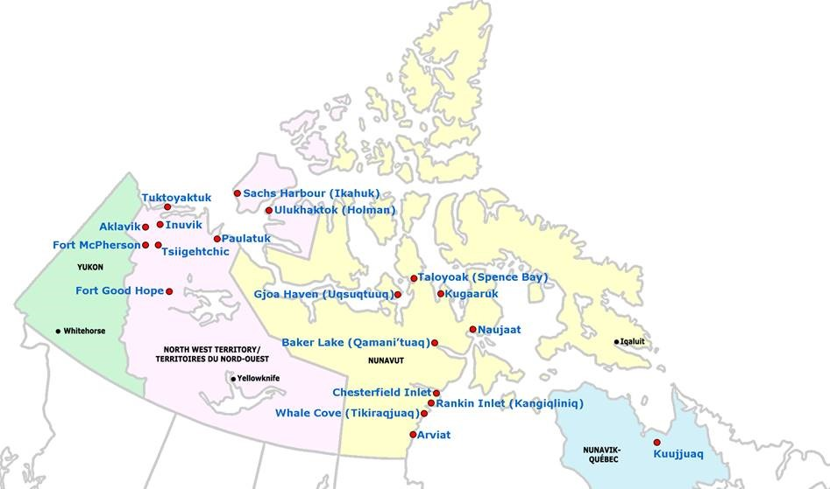

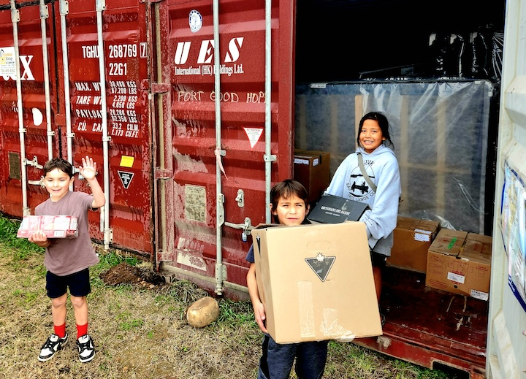
The North of 60 project provides food security to those living in northern communities.
Works of SSVP in Canada
Assistance given to 18 Indigenous communities

Slide 17

Works of SSVP in Canada
Summer camps

Slide 18
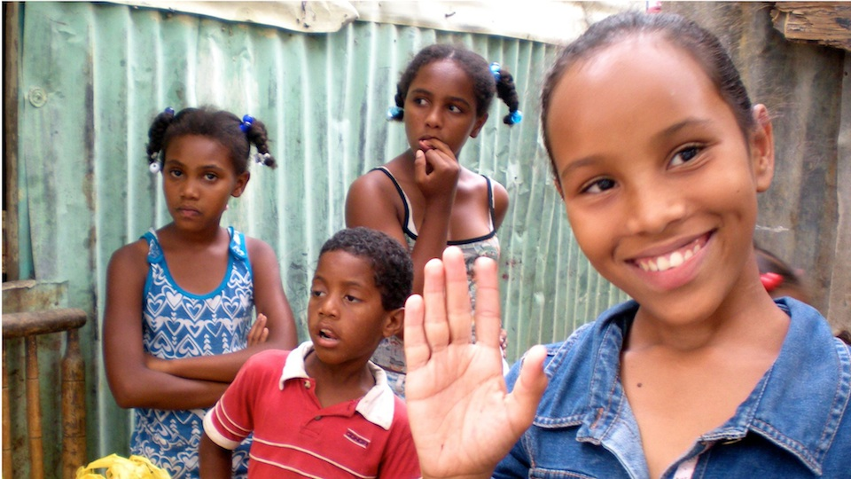
Works of SSVP in Canada
196 twinning agreements
with 18 countries

Slide 19

Works of SSVP in Canada
National & International Emergency relief
Natural disasters and humanitarian disasters

Slide 20
Society of Saint Vincent de Paul
Please donate on
November 17
World Day
of the Poor.
To make a donation,
please contact us:
ssvp.ca/donate
Charity Registration No: 132410671RR0001

