Slide 1

Society of Saint Vincent de Paul

Slide 2
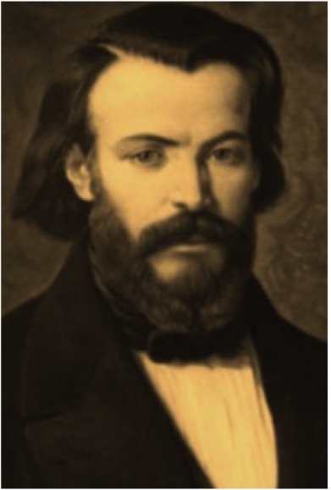
Blessed Frédéric Ozanam
“Charity is the Samaritan who pours oil on the wounds of the traveler who has been attacked. It is justice’s role to prevent the attack.”

Slide 3
Society of Saint Vincent de Paul (SSVP)
MISSION
The Society of Saint Vincent de Paul is a lay
Catholic organization whose mission is:
To live the Gospel message by serving Christ in the poor with love, respect, justice and joy.

Slide 4
Society of Saint Vincent de Paul (SSVP)
VALUES
The Mission of the Society of Saint Vincent de Paul implies that as Vincentians, we:
see Christ in anyone who suffers;
come together as a family;
have personal contact with the poor;
help in all possible ways.

Slide 5
Society of Saint Vincent de Paul (SSVP)
VISION
As a Catholic lay organization, we will embrace the world in a network of charity, serving Christ in the suffering, poor or marginalized, bringing them love and respect, aid and development, hope and joy, in a more just society.
We also seek to deepen our spirituality and the mutual love and support amongst members, so that, seeing how we serve those in need with one mind and heart, people are attracted to the Society and to Christ who animates it.

Slide 6
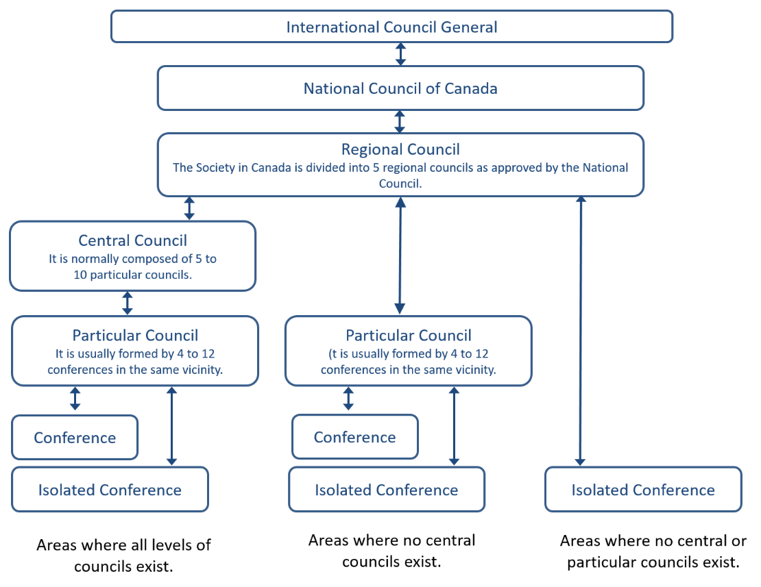

Organizational Chart - SSVP Canada
Vincentian
Family Tree

Slide 7
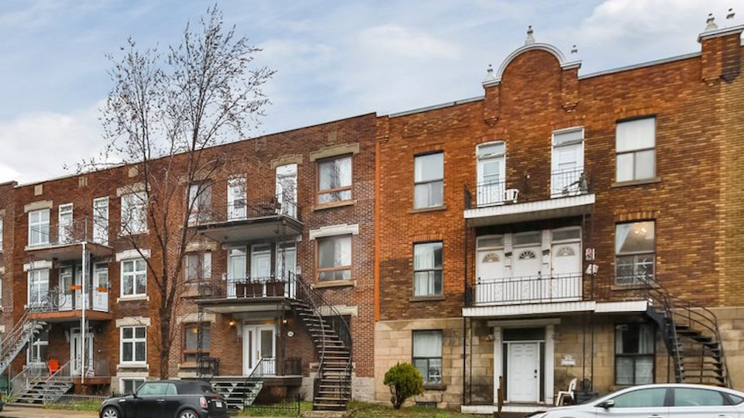
Works of SSVP in Canada
Home visits

Slide 8

Works of SSVP in Canada
Friendly visits

Slide 9
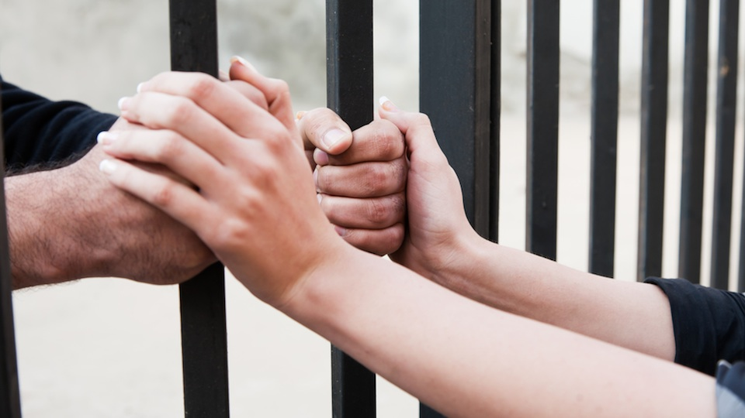
Works of SSVP in Canada
Visits to prisoners

Slide 10
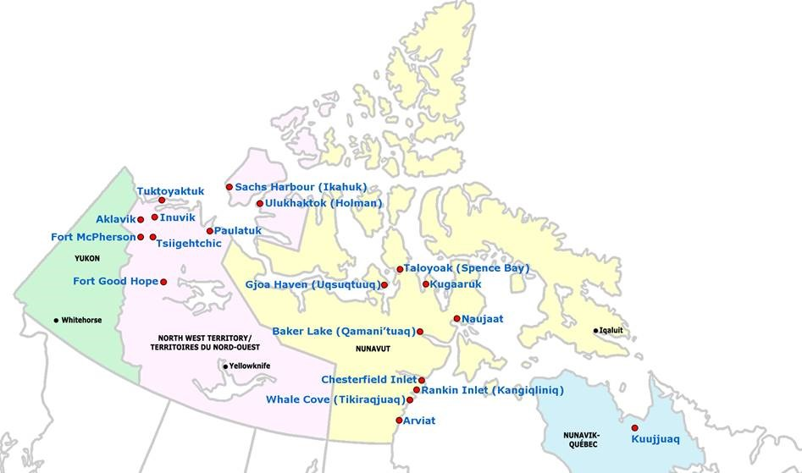
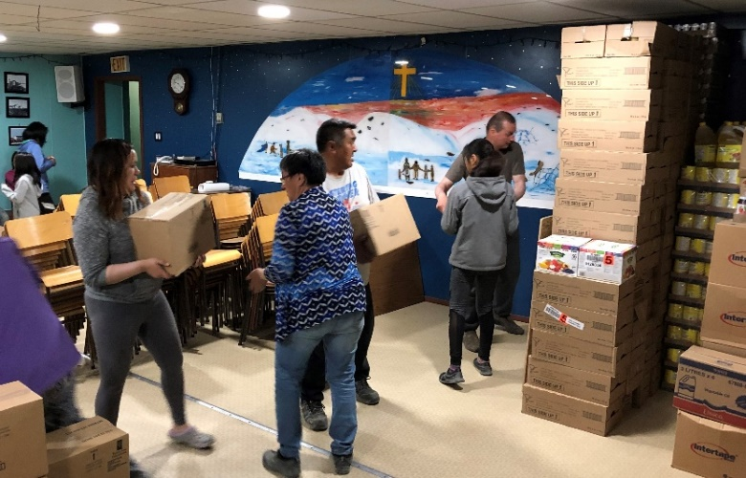
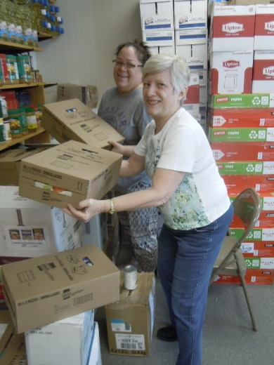
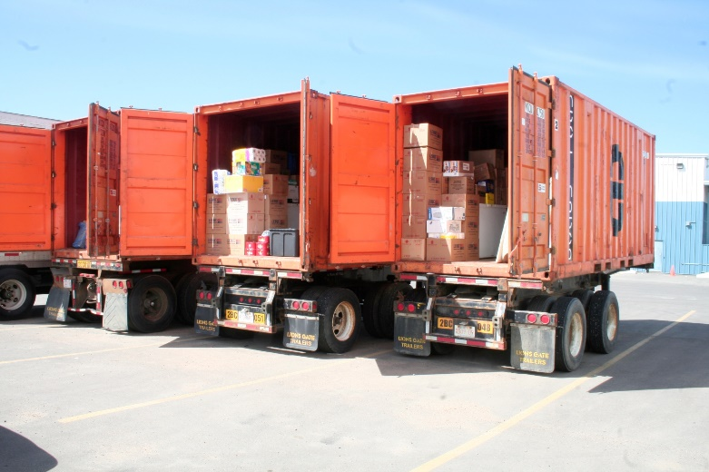

The North of 60 project provides food security to those living in northern communities.
Indigenous communities across Canada receive assistance from Vincentians.

Slide 11
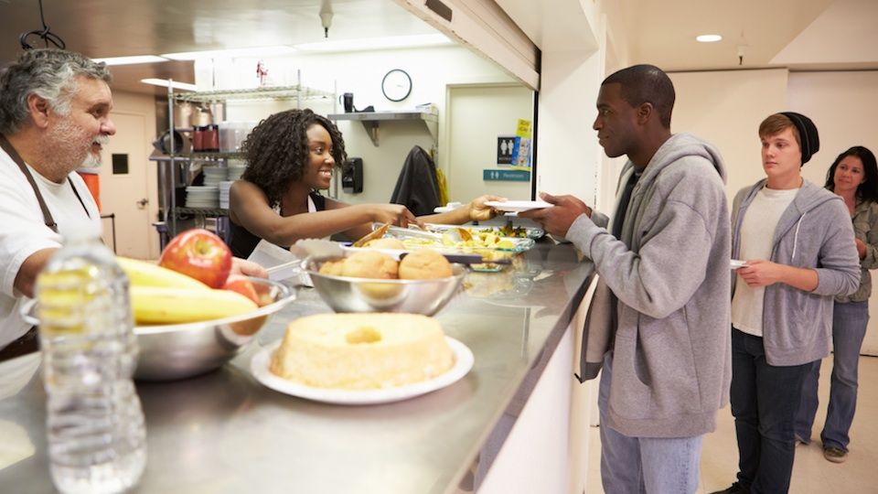
Works of SSVP in Canada
Soup Kitchens

Slide 12
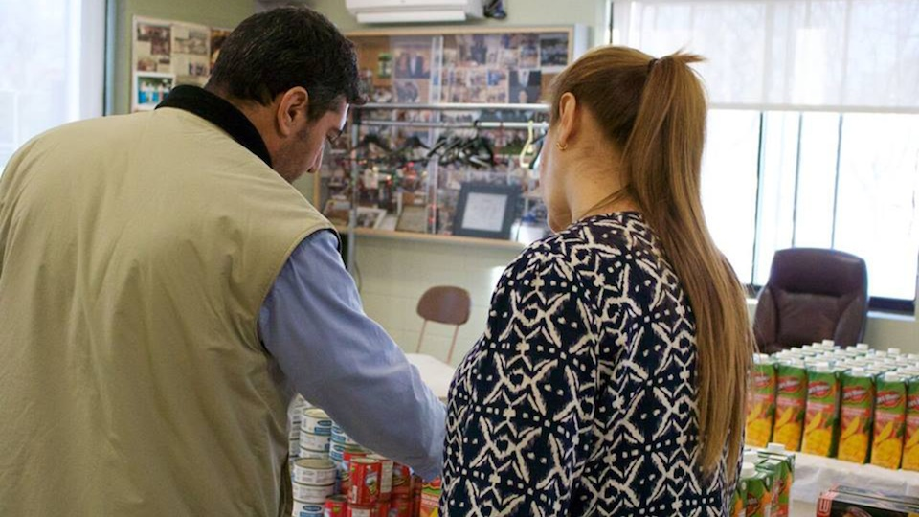
Works of SSVP in Canada
Food banks

Slide 13
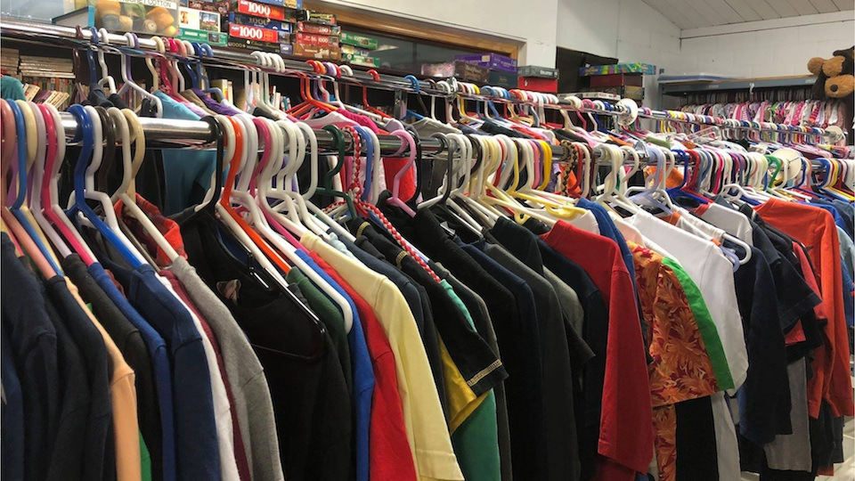
Works of SSVP in Canada
Material help
Clothes & accessories

Slide 14
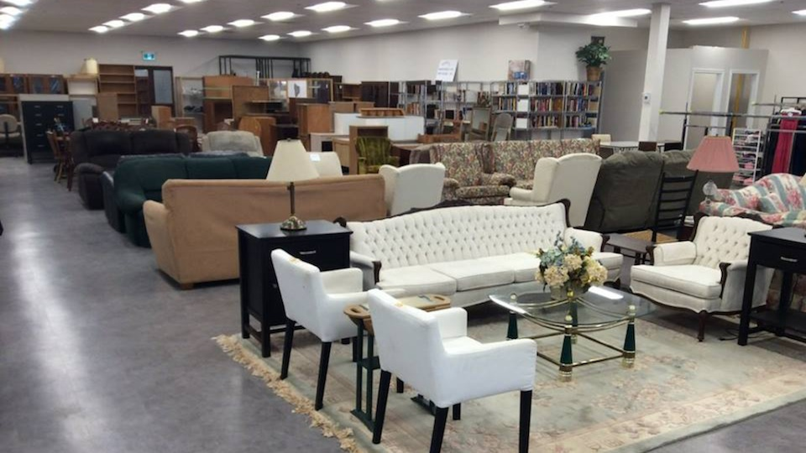
Works of SSVP in Canada
Material help
Furniture

Slide 15

Works of SSVP in Canada
Educational support
School supplies

Slide 16

Works of SSVP in Canada
Educational support
Scholarships

Slide 17

Works of SSVP in Canada
Help to
Refugees & immigrants

Slide 18

Works of SSVP in Canada
Shelters
homeless, single mothers, abused persons

Slide 19

Works of SSVP in Canada
Summer camps

Slide 20
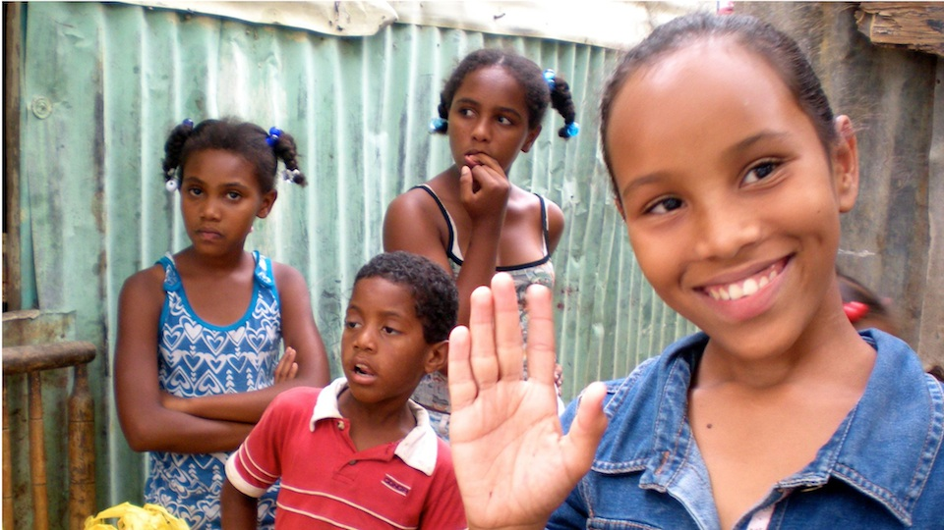
Works of SSVP in Canada
Twinning with
other countries

Slide 21
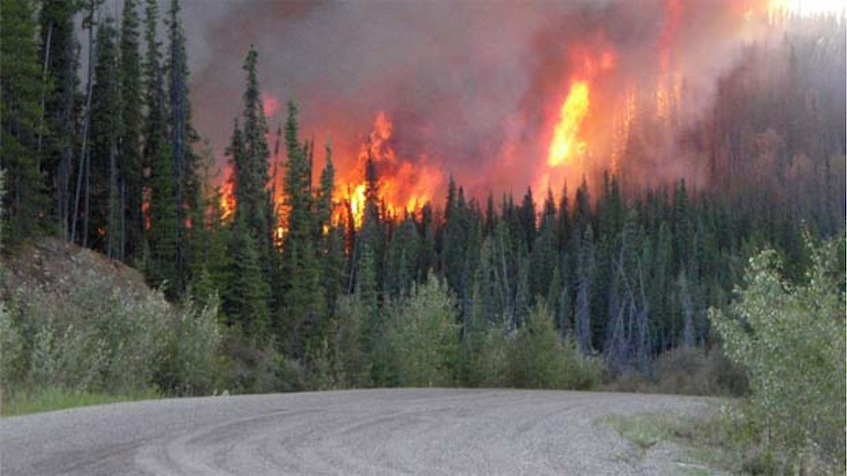
Works of SSVP in Canada
Emergency relief
National & International
Natural disasters and humanitarian disasters

Slide 22
Works of SSVP in Canada
Number of visits made
145,000

Slide 23

Works of SSVP in Canada
Number of people helped at home
213,000

Slide 24
Extent of the Society
    Number of members: 11,050
    Number of regional councils: 5
    Number of central councils: 13
    Number of particular councils: 92
    Number of conferences: 833

Slide 25
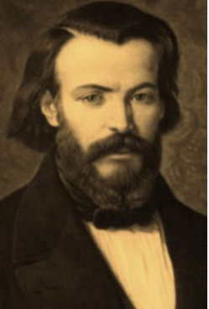

Blessed Frédéric Ozanam
Frederic observed the real situation of the poor and sought to be more and more effective in helping them in their human development. Charity and justice go together. Frederic had the clear-sighted courage to seek a front-line social and political commitments in a troubled time in the life of his country.
Pope John Paul II: August 22, 1997, Frédéric Ozanam beatification ceremonies

Slide 26

Safe, Secure And Affordable Housing is a Human Right
Everyone deserves to have safe and adequate housing for their families.

Slide 27

November 19, 2023
33rd Sunday of Ordinary Time
WORLD DAY OF THE POOR

Slide 28
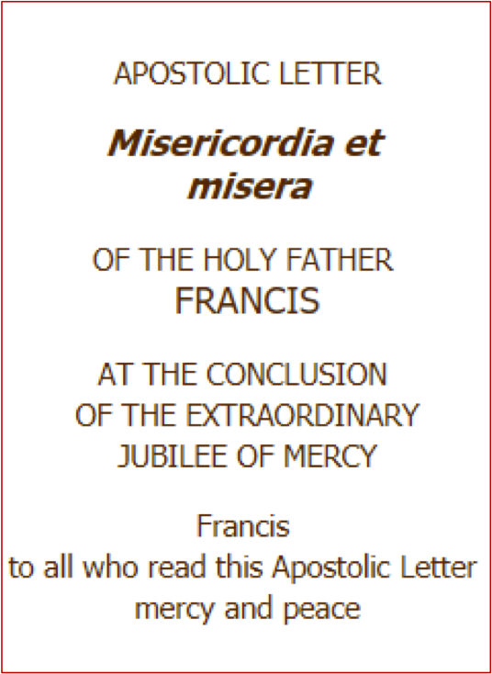
During the “Jubilee for Socially Excluded People”, as the Holy Doors of Mercy were being closed in all the cathedrals and shrines of the world, I had the idea that, as yet another tangible sign of this Extraordinary Holy Year, the entire Church might celebrate, on the Thirty-Third Sunday of Ordinary Time, the World Day of the Poor. This would be the worthiest way to prepare for the celebration of the Solemnity of our Lord Jesus Christ, King of the Universe, who identified with the little ones and the poor and who will judge us on our works of mercy (cf. Mt 25:31-46).
Source: https://w2.vatican.va/content/francesco/en/apost_letters/documents/papa-francesco-lettera-ap_20161120_misericordia-et-misera.html

Slide 29

Please donate on
November 19,
World Day
of the Poor.
ssvp.ca/donation
To make a donation,
please contact us:
ssvp.ca/donation
Society of Saint Vincent de Paul
2463 Innes Road
Ottawa ON K1B 3K3
1.866.997.7787
Charity Registration No: 132410671RR0001
Society of Saint Vincent de Paul

Slide 30
